Slide 1
Online COVID TEST and VACCINATION Booking System
WE MAKE SURE U CAN GET UR COVID TEST AS FAST AS POSSIBLE

Slide 2
INDEX
ORDER OF PRESENTATION
BOOKING A COVID TEST
BOOKING A VACCINATION APPOINTMENT
FRONT END
BACK END
DATABASE

Slide 3

ABOUT US
Name | AHMED ALI, MUHAMMAD ASAD QURESHI, ALI SHAHID,
Enrollment No. | Student1342492, Student1342494,Student1342632,Student1336479
Curriculum | ACCP PRIME2.9
Semester | 2ND SEMESTER
Centre Name | APTECH NORTH NAZIMABAD

Slide 4
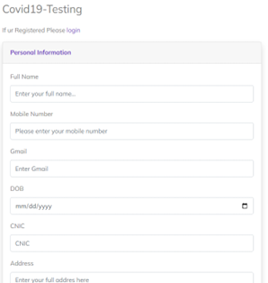
Online COVID TEST and VACCINATION Booking System
App will provide Online Registration System (ORS) is a framework to link various hospitals across the country for mobile number based online registration and appointment system. Portal facilitates online appointments for vaccination. Detail reports showing information about test and vaccination patients taking appointment through this portal can be seen. Hospitals can come on board this platform and provide their appointment slots for online booking by patients. The system facilitates Hospitals to easily manage their registration and appointment process and monitor the flow of patients

Slide 5
What help we give to a patient?
Patient can book an covid test appointment.
Patient can search through a provided orderno for their covid status from home.
Patient can view all available vaccines and registered hospitals to have choice to book the nearest ones.
Patient can select a timeslot for easy covid test/vaccination.
Patient after login/signup can view their test reports without searching through orderno

Slide 6
Booking an covid test
We will go through how the data moves

Slide 7
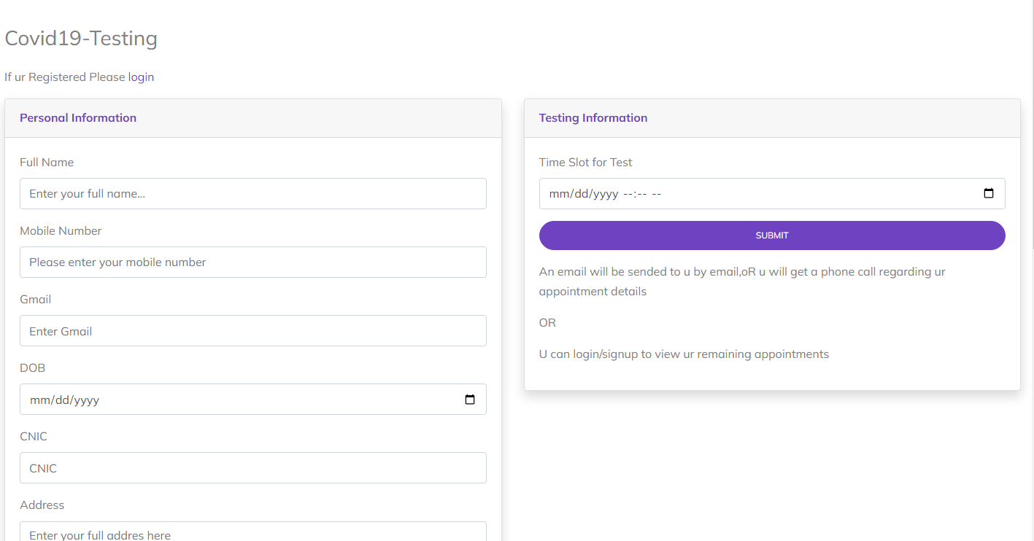
First a patient fill their detail and after then he gets an alert of order no

Slide 8
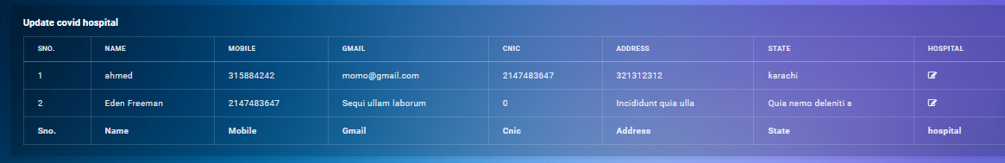
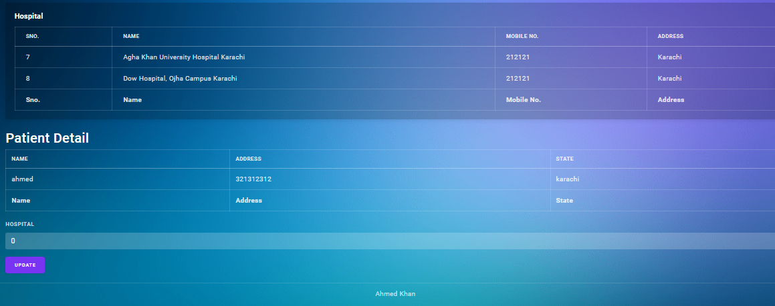
After booking from patient side data comes to admin where he select the nearest hospital with patient timeslot selected

Slide 9
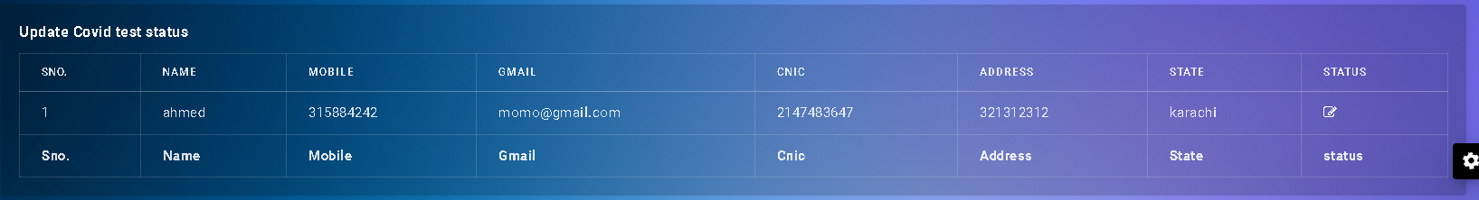
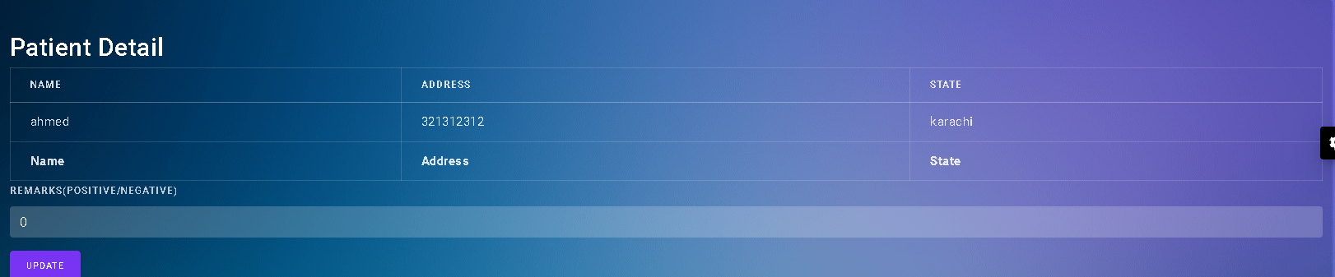
When covid test is completed then selected hospital login and update patient remarks

Slide 10
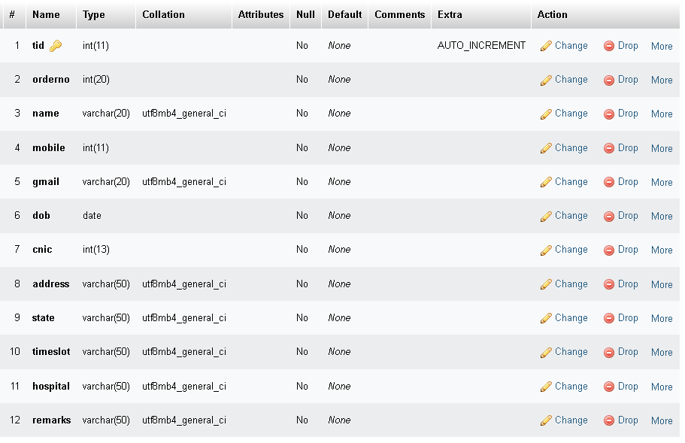

Slide 11
BOOKING A VACCINATION APPOINTMENT
We will go through how the data moves

Slide 12
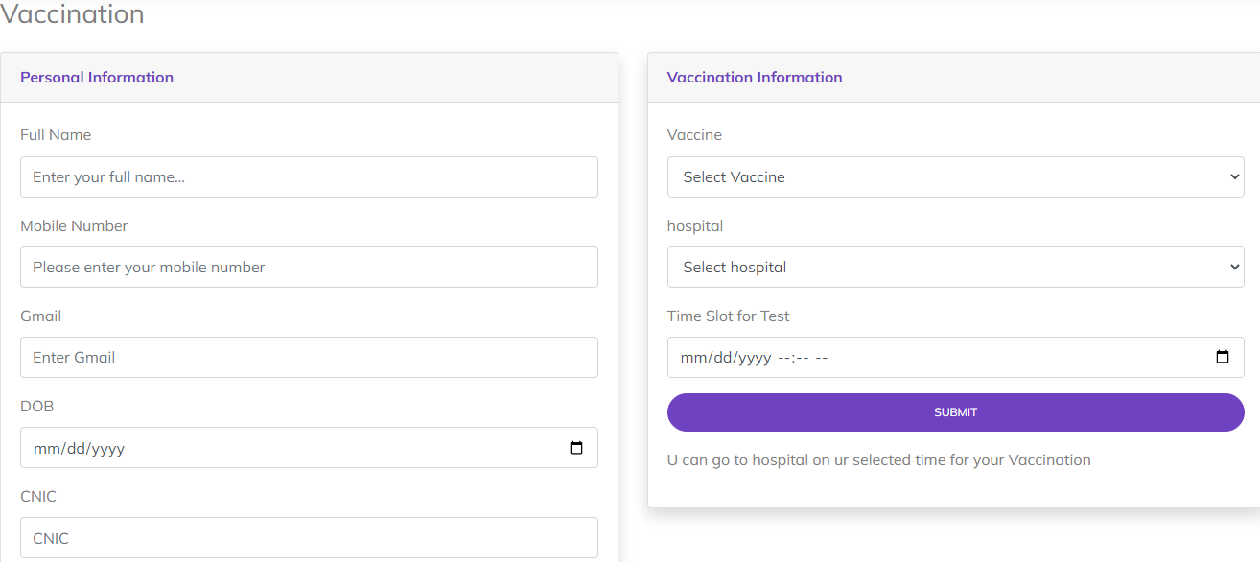
First a patient fill their detail and at their selected time he/she can visit selected hospital for vaccination

Slide 13
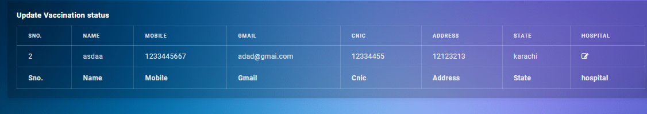
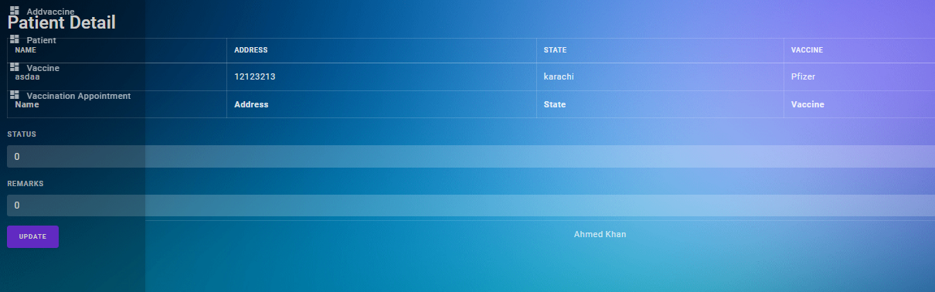
When Vaccination is completed then selected hospital login and update patient remarks like in status(1st dose,2nd dose,full dose)

Slide 14
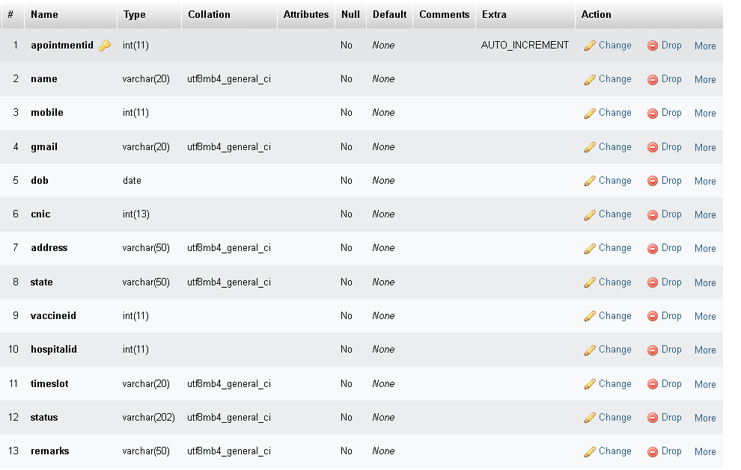

Slide 15
Front end

Slide 16
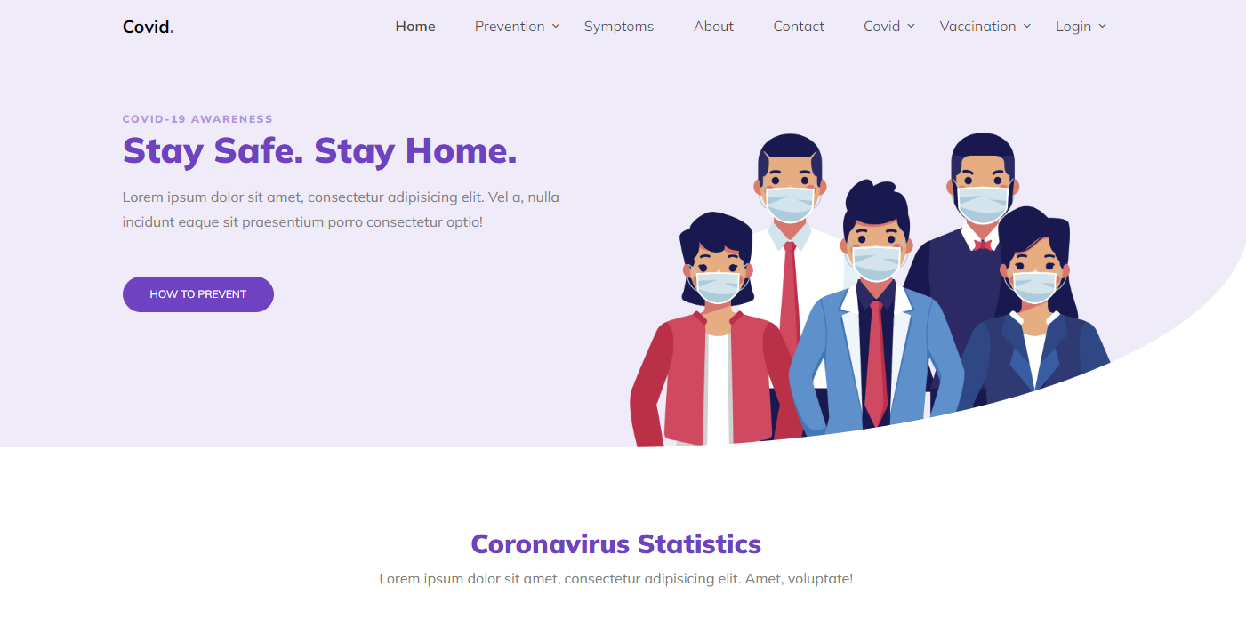
Here a patient can Book A covid test or vaccination appointment or login/signup

Slide 17
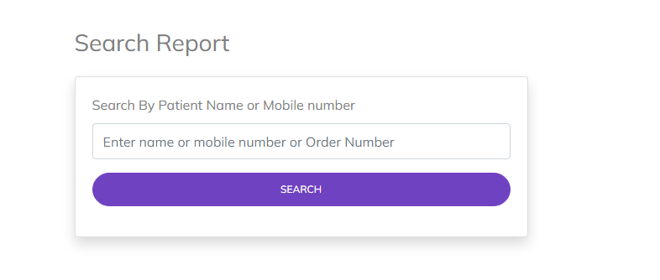

Slide 18
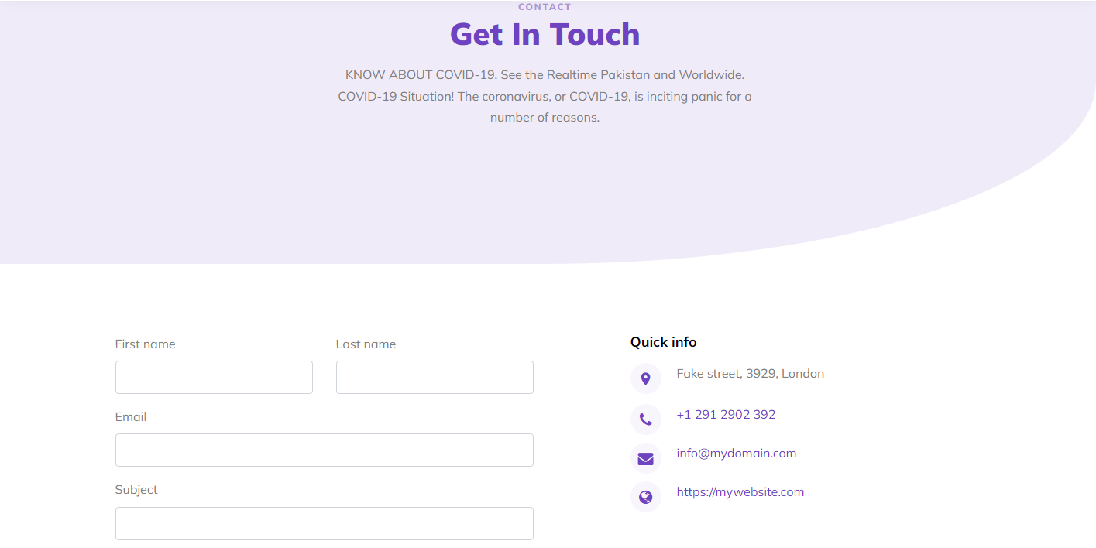
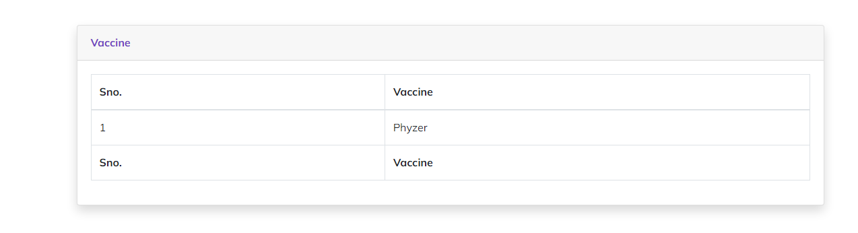

Slide 19
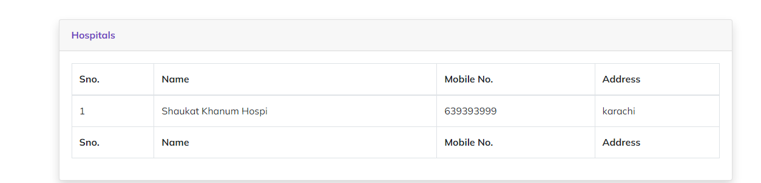

Slide 20
Back End

Slide 21
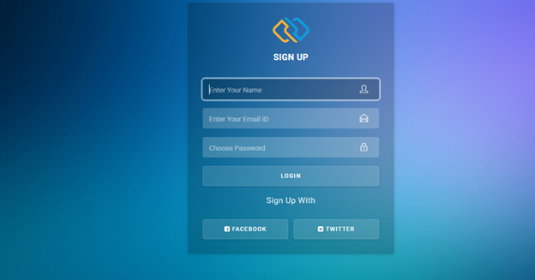
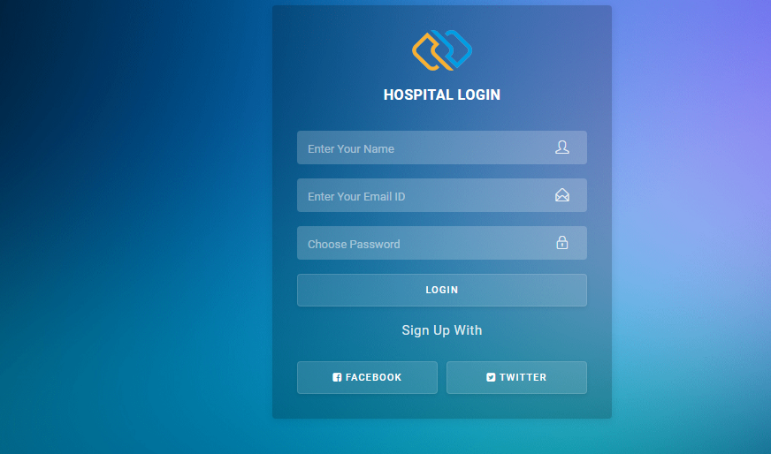
Admin login
Hospital Login

Slide 22
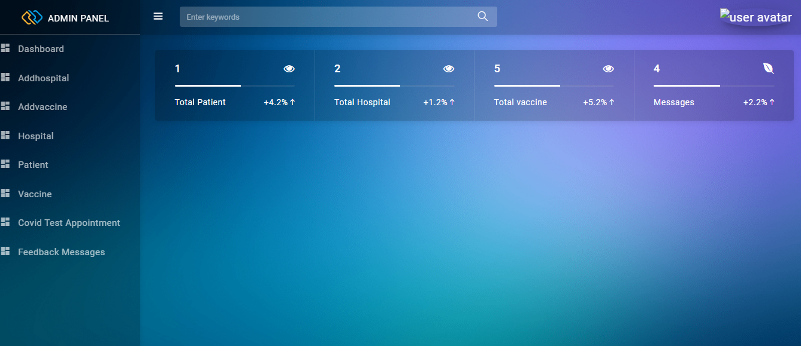

Slide 23
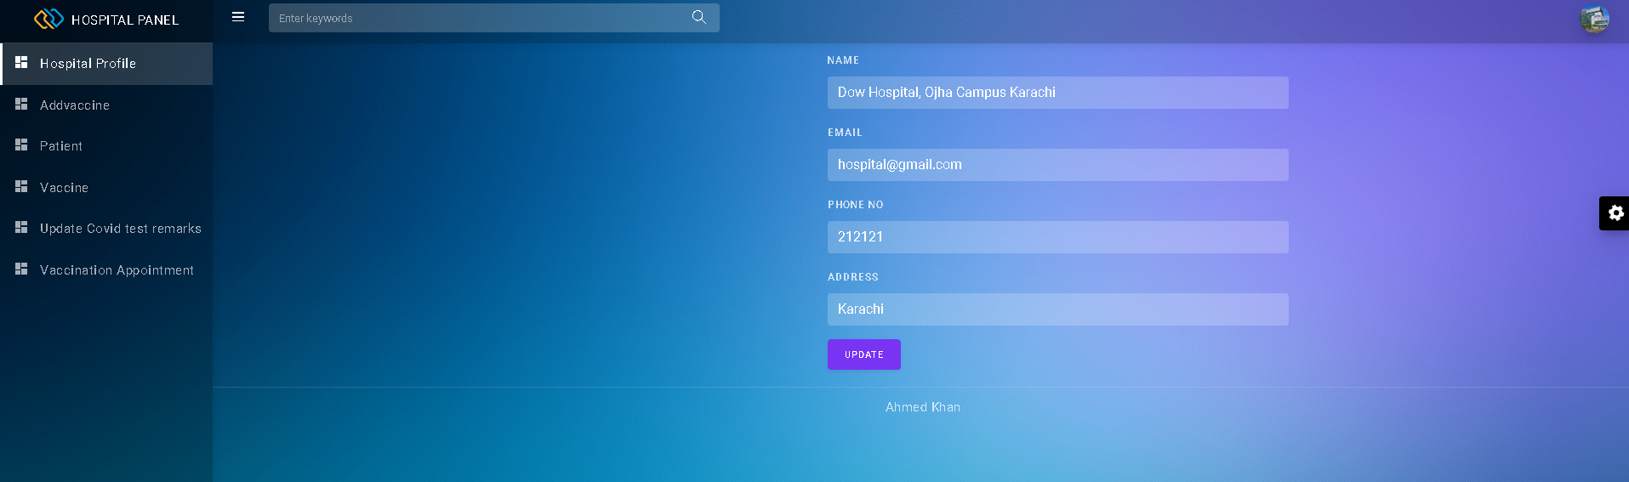

Slide 24
DATABASE

Slide 25
